Slide 1

$500
$300
New Squad
Squad +3
Offensive Classes
Defensive Classes
Specialized Classes

Slide 2

$500
$300
New Squad
Squad +3
Offensive Classes
Defensive Classes
Specialized Classes

Slide 3
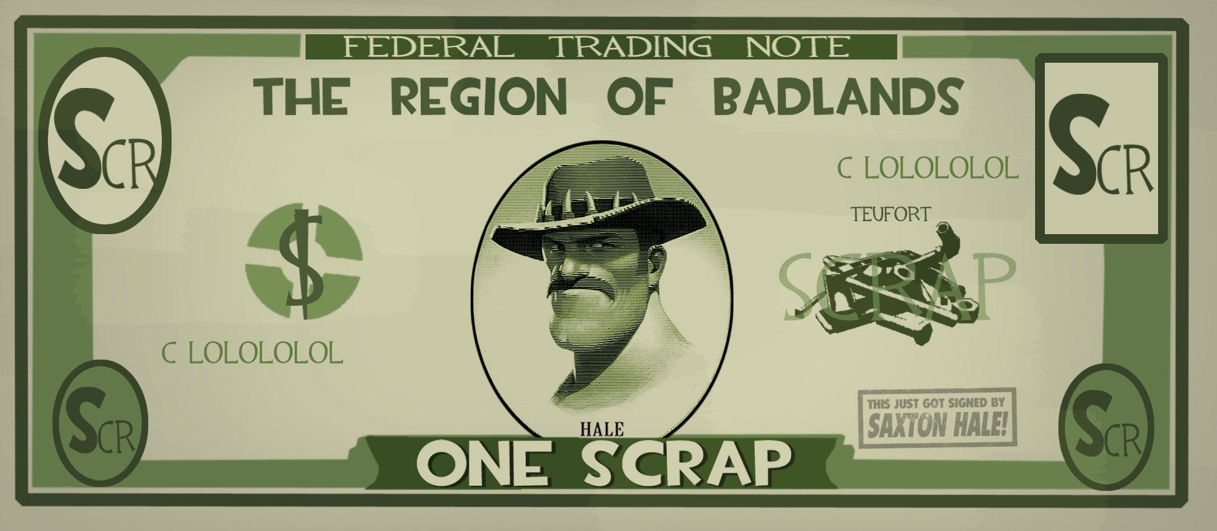
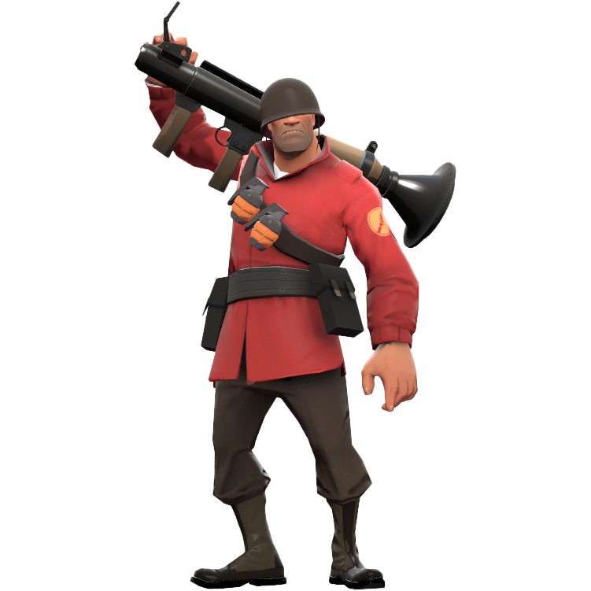




You Must Unlock These Classes First
FIGHT MONEY
MANN COMPANY OFFICIAL

Slide 4

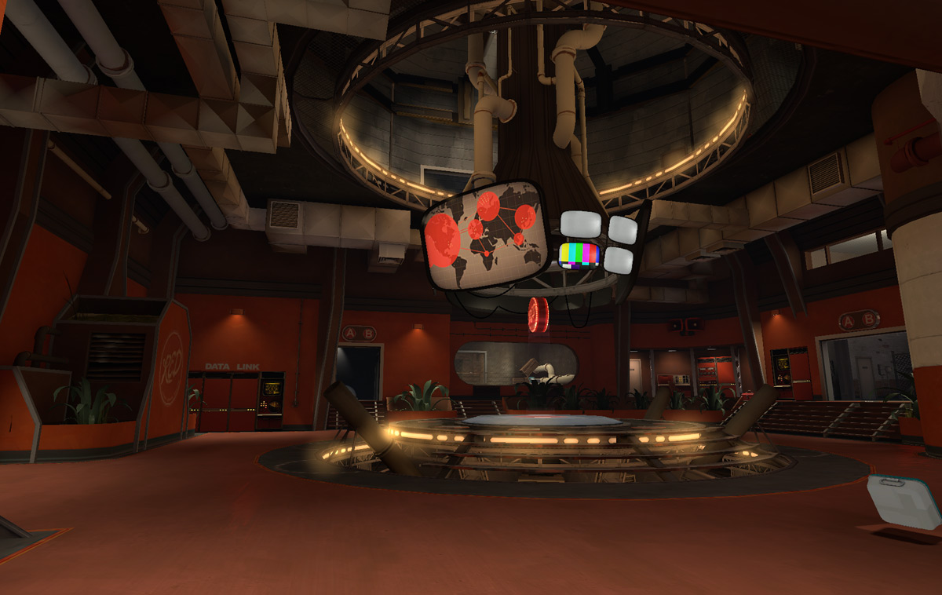
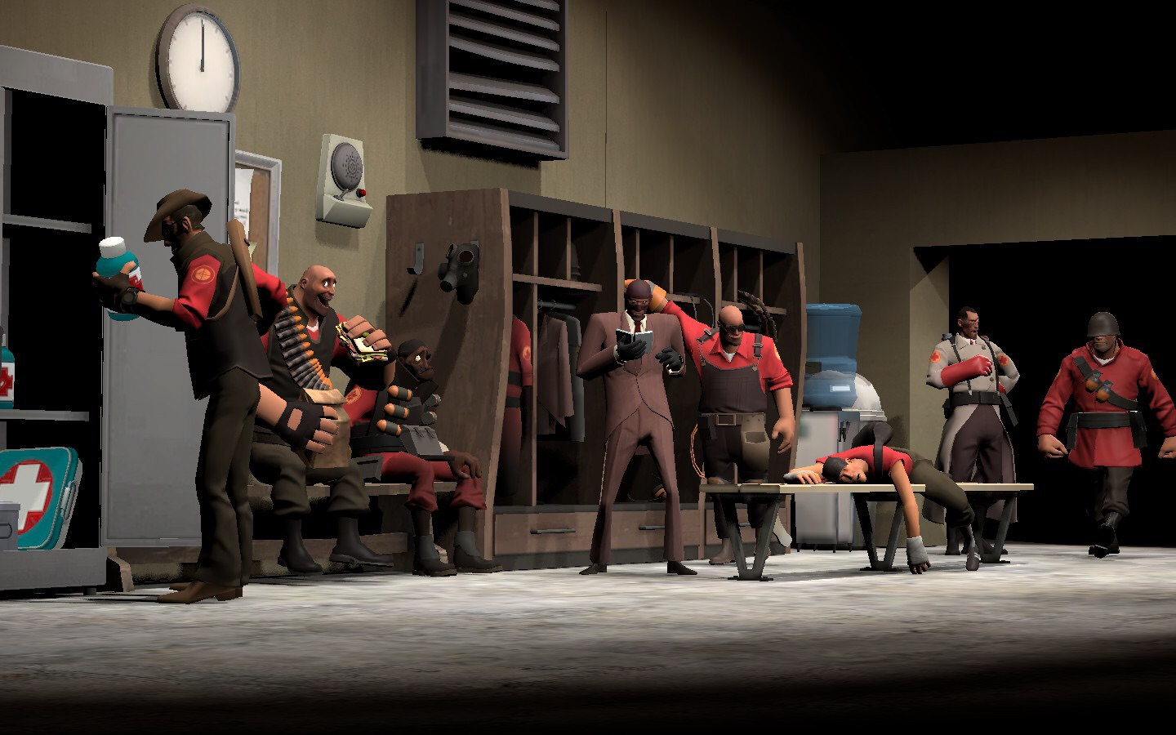
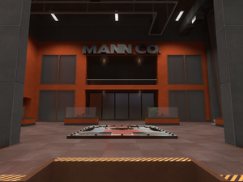

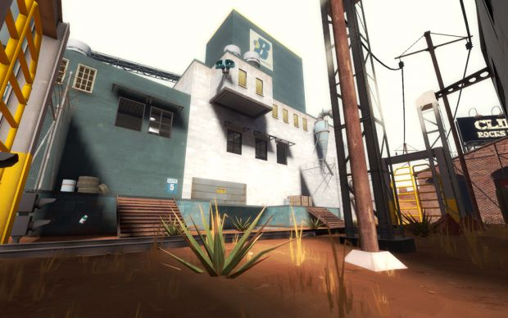

Barracks
$500
Boot Camp
$500
Headquarters
Building----RED
--n/a--
Building----RED
--n/a--
Building----RED
--n/a--
This building is used to re-equip your attack squads and provide reinforcements to defense squads
This building is used to recruit new Attack Squads
This building is where Reliable Excavations & Demolitions Coordinates its Combat Operations.
Barracks
$500
Boot Camp
$500
Headquarters
Building----BLU
--n/a--
Building----BLU
--n/a--
Building----BLU
--n/a--
This building is used to re-equip your attack squads and provide reinforcements to defense squads.
This building is used to recruit new Attack Squads.
This building is where Builder’s League United Coordinates its Combat Operations.

Slide 5
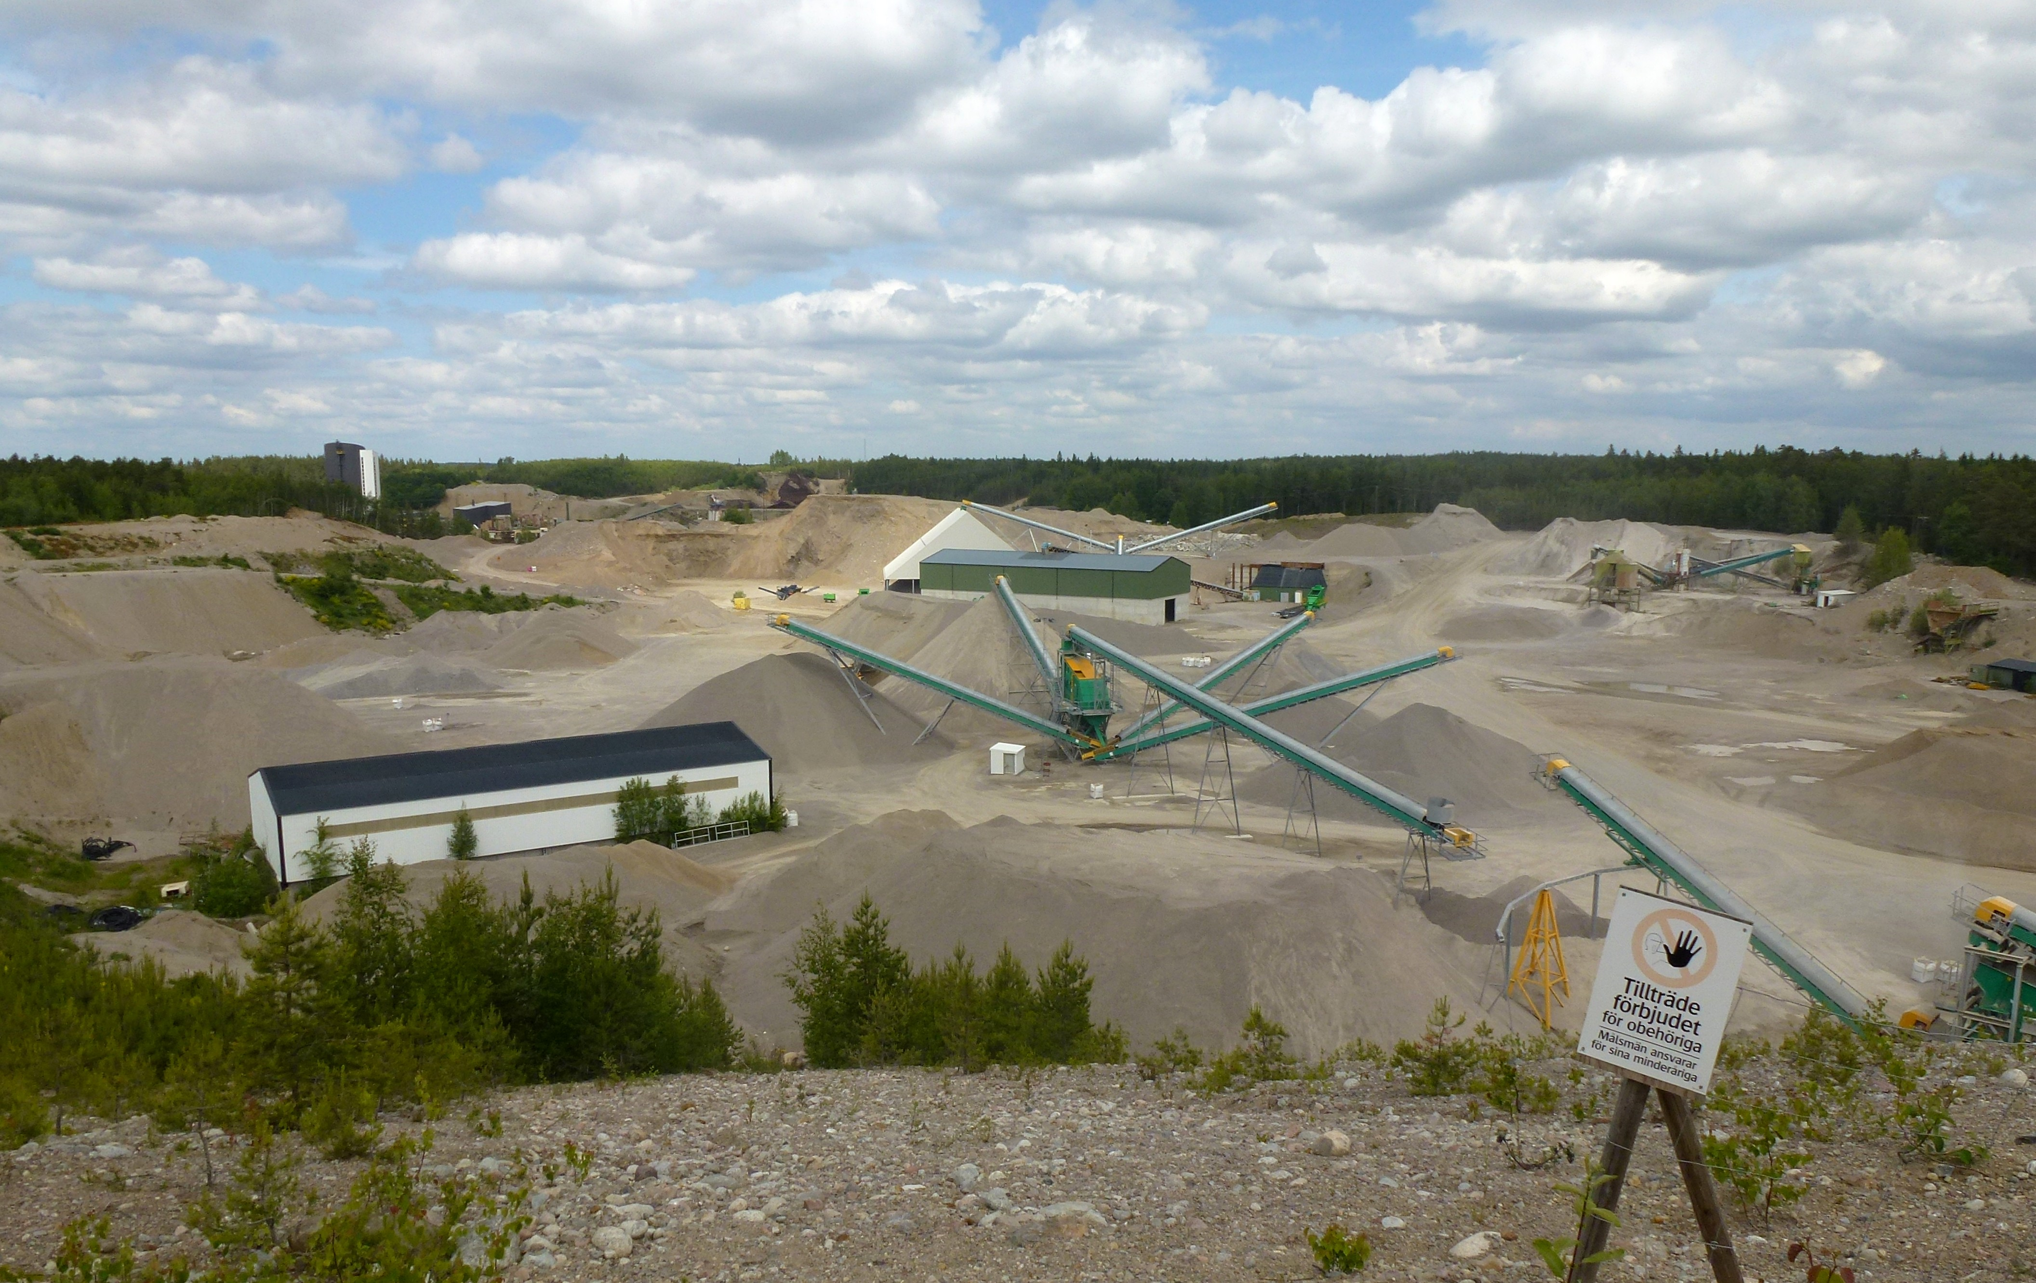
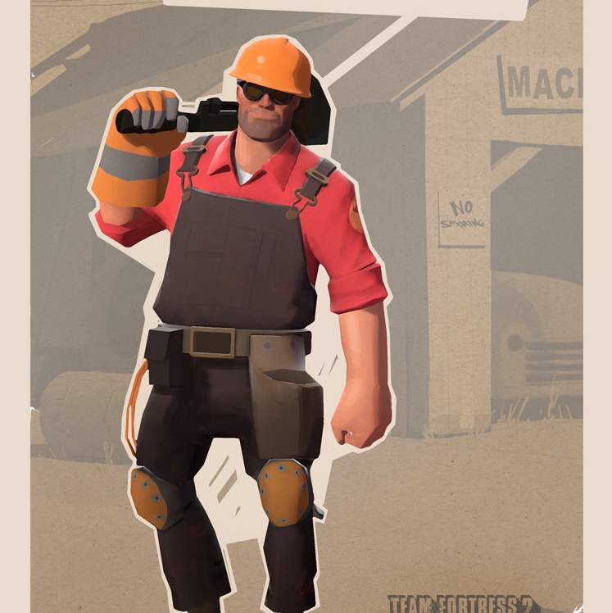
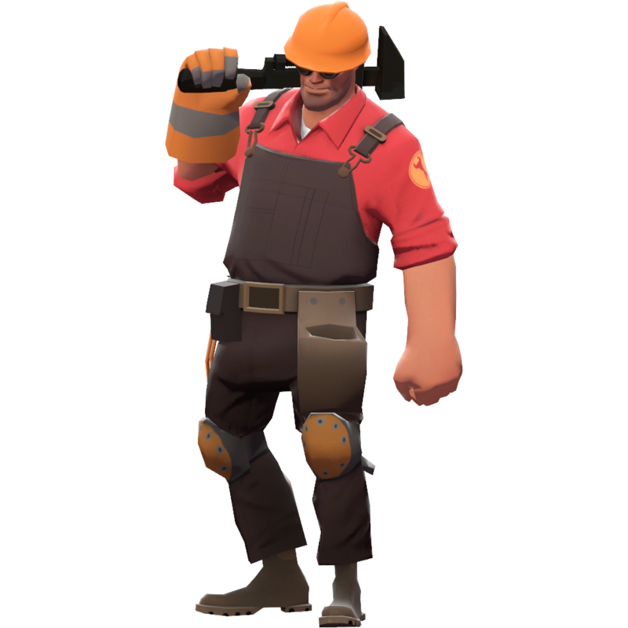
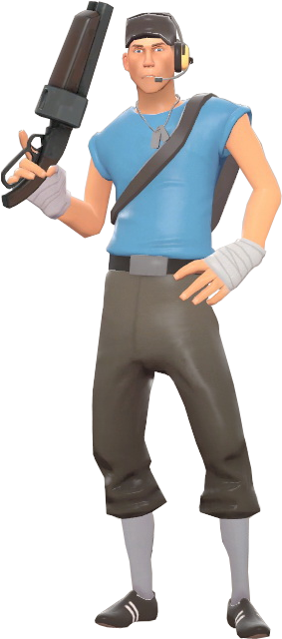
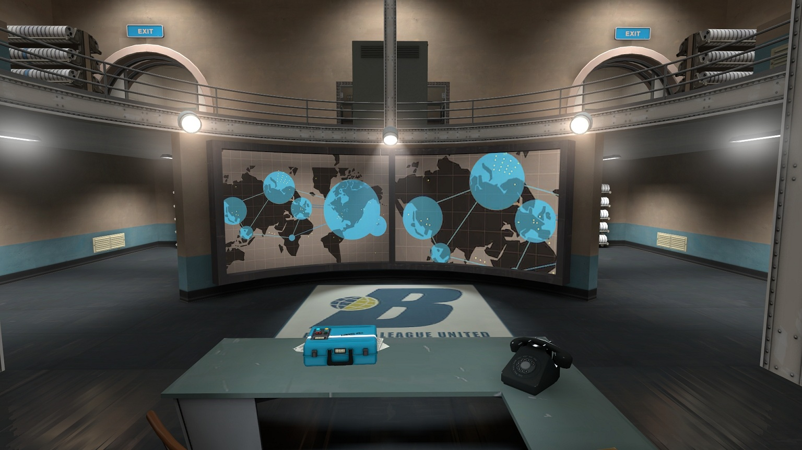
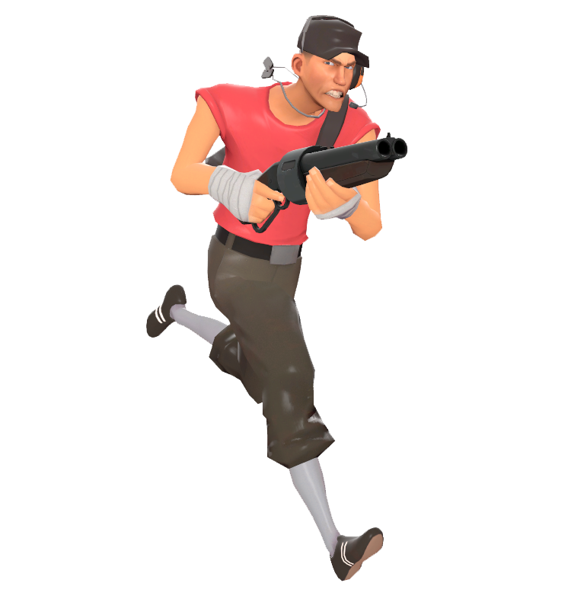

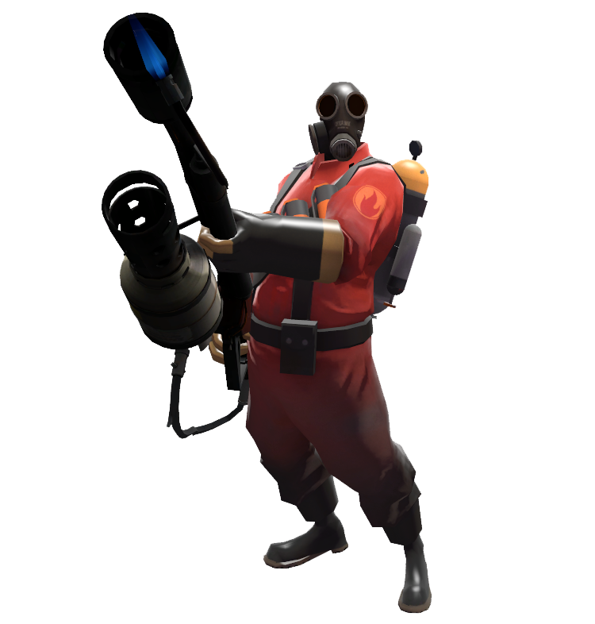
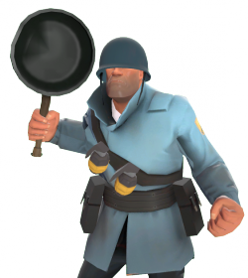
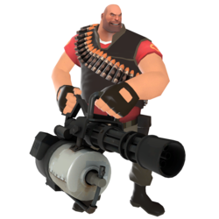
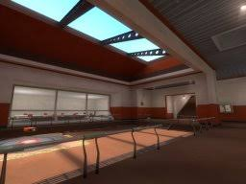
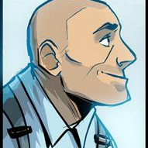

Quarry
$500
Lab
$250
Engineer
$ 250
Squad +
$ 300
UNL Offensive
DEPRECATED
Mine----RED
750
Research Building-------RED
Field Agent-----RED
--N/A--
Upgrade
750
Research
1000
This building mines highly valuable GRAVEL and sends it to your boss. (He generously pays on commission)
This building is where the eggheads bang science rocks together…to fight wars JUST LIKE SUN TZU!
I Like to Make Things. This field agent is responsible for constructing bases and buildings, and can be used to bolster defense and attack squads.
“Let’s Even this Out.” Increase your Squad Size by 3, up to a maximum of 12.
“” If fighting is sure to result in victory, then you must fight!” Research this to unlock the ability to add the offensive class types to defensive teams(Scout/Soldier/Pyro)
Quarry
$ 500
Lab
$ 250
Engineer
$ 250
Squad +
$ 300
UNL Offensive
DEPRECATED
Mine----BLU
750
Research Building------BLU
Field Agent-----BLU
--N/A--
Upgrade
750
Research
1000
This building mines highly valuable GRAVEL and sends it to your boss. (He generously pays on commission)
This building is where the eggheads bang science rocks together…to fight wars JUST LIKE SUN TZU!
I Like to Make Things. This field agent is responsible for constructing bases and buildings, and can be used to bolster defense and attack squads.
Let’s Even this Out.” Increase your Squad Size by 3, up to a maximum of 12.
“” If fighting is sure to result in victory, then you must fight!” Research this to unlock the ability to add the offensive class types to defensive teams(Scout/Soldier/Pyro)

Slide 6
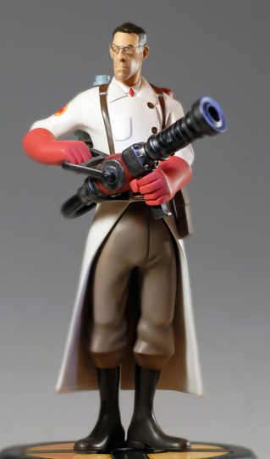
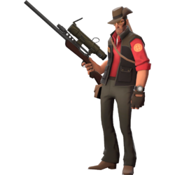
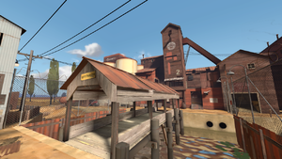
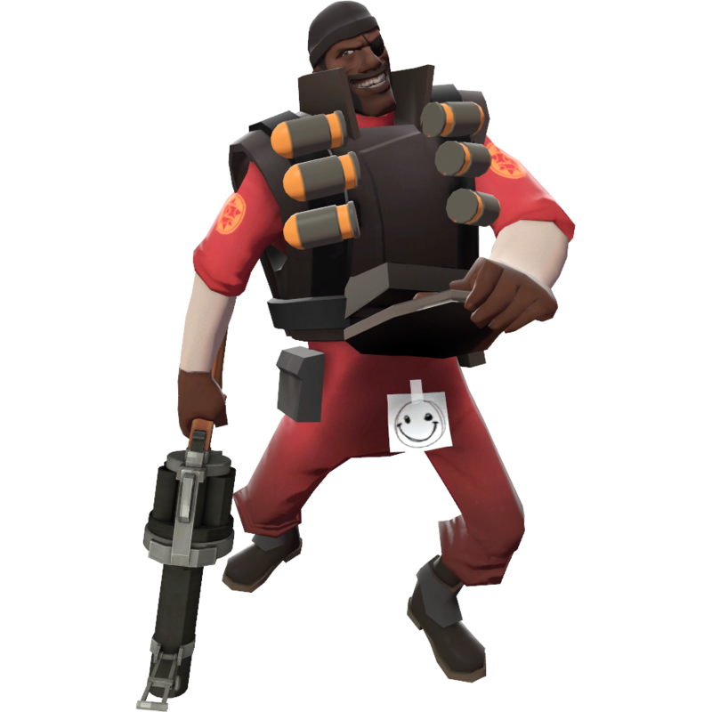
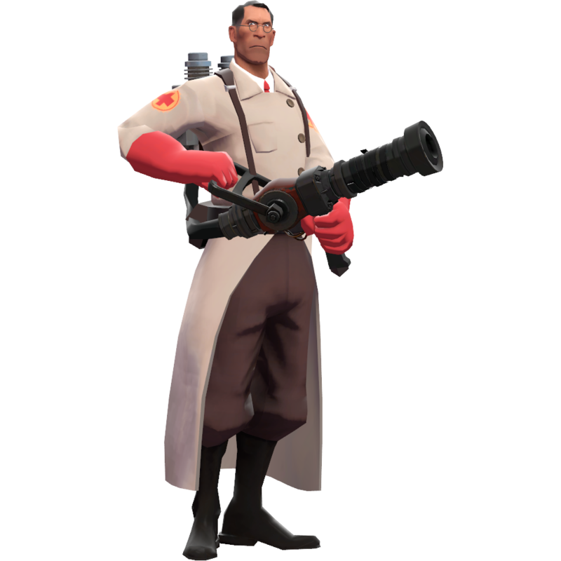
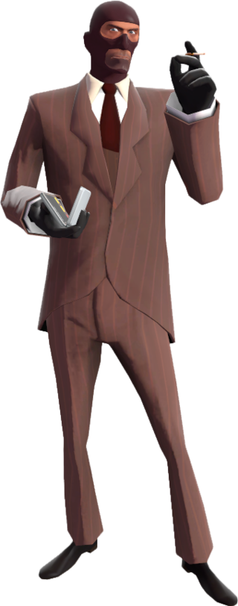

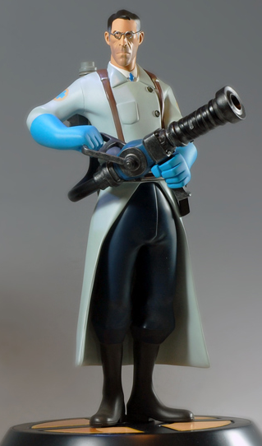
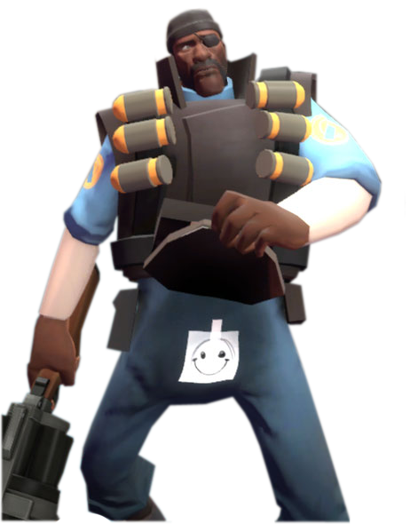
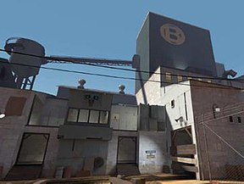
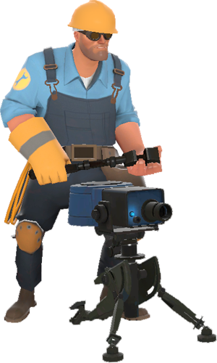
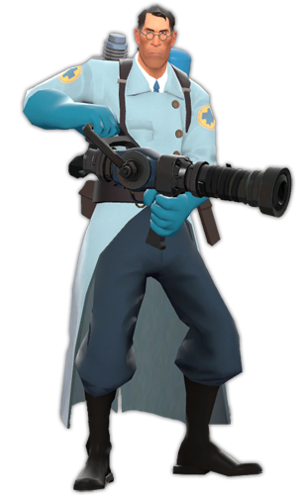
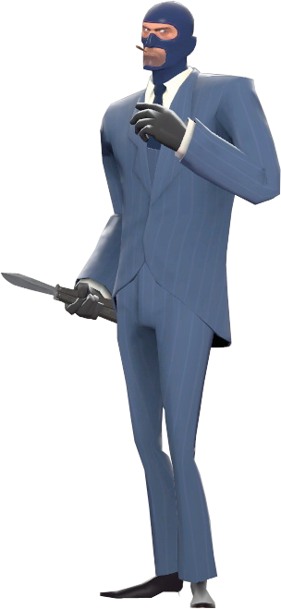
UNL Defensive
UNL Specialist
New Base
$250
Fortress
$250
MEDIC!
$ 350
DEPRECATED
DEPRECATED
Research
1000
Research
1000
Building----RED
--n/a--
BASE Lv2----BLU
--N/A--
Field Agent-----RED
--N/A--
“” Are you dangerous like Heavy, or coward like Scout?” Research this to unlock the ability to add the defensive class types to offensive teams (Demoman/Heavy/Engineer).
“…let’s go practice medicine!” Research this to unlock the ability to add the Specialist class types to all teams (Medic/Sniper/Spy).
“This map ain’t big enough for da two of us!” Construct a new base on existing neutral territory.
“”Let’s do this Texas Style.” Upgrade an existing base to a Fortress. Adds 1 building slot to Base.
Blood! I need more BLOOD! This field agent is responsible for keeping his teammates alive, and failing that, bringing them back.
UNL Defensive
UNL Specialist
New Base
$250
Fortress
$250
MEDIC!
$ 350
DEPRECATED
DEPRECATED
Research
1000
Research
1000
BASE LV1----BLU
--n/a--
BASE Lv2----BLU
--N/A--
Field Agent-----BLU
--N/A--
“” Are you dangerous like Heavy, or coward like Scout?” Research this to unlock the ability to add the defensive class types to offensive teams (Demoman/Heavy/Engineer).
“…let’s go practice medicine!” Research this to unlock the ability to add the Specialist class types to all teams (Medic/Sniper/Spy).
“This map ain’t big enough for da two of us!” Construct a new base on existing neutral territory.
“”Let’s do this Texas Style.” Upgrade an existing base to a Fortress. Adds 1 building slot to Base.
Blood! I need more BLOOD! This field agent is responsible for keeping his teammates alive, and failing that, bringing them back

Slide 7
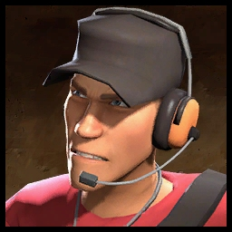
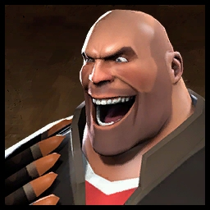
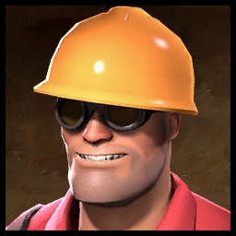
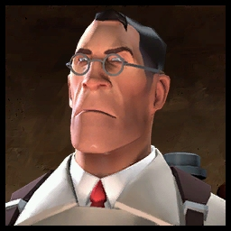
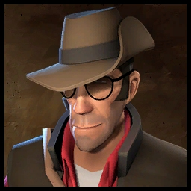
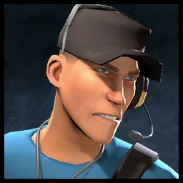
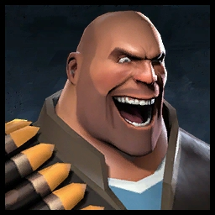
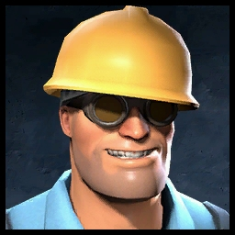
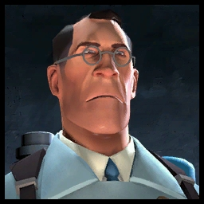
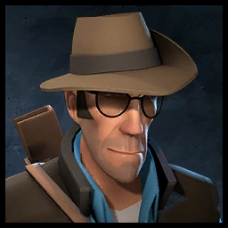
Jeremy
Misha
Dell Conagher
Dr. Ludwig
Mr. Mundy
Scout--------------RED
350
Heavy--------------RED
350
Engineer---------RED
450
MEDIC---------RED
550
Sniper--------------RED
350
Too. Much. Caffeine. Unlocks the Scout Class for use in Squads. He likes to run. A Lot. Everywhere. Oh and shoot things.
Give Teeth to Russian tooth-fairy. Those are the people’s teeth. For all to share. Unlocks the Heavy Weapons guy for use in Squads. His preferred role: Mow Down.
I Solve Practical Problems. Unlocks the Engineer for use in Squads. He builds things. He also has a robot hand.
The Only thing I can tell you about this next procedure, is that it will be excruciating. Unlocks the Medic for use in Squads. His specialty: Doctor assisted Homicide.
Everything above your neck is gonna be a fine red mist! Unlocks the Sniper for use in Squads. His advice: “Don’t stand around like a bloody idiot’
Jeremy
MIsha
Dell Conagher
Dr. Ludwig
Mr. Mundy
Scout---------------BLU
350
Heavy---------------BLU
350
Engineer----------BLU
450
Medic---------------BLU
550
Sniper--------------BLU
350
Too. Much. Caffeine. Unlocks the Scout Class for use in Squads. He likes to run. A Lot. Everywhere. Oh and shoot things.
Give Teeth to Russian tooth-fairy. Those are the people’s teeth. For all to share. Unlocks the Heavy Weapons guy for use in Squads. His preferred role: Mow Down.
I Solve Practical Problems. Unlocks the Engineer for use in Squads. He builds things. He also has a robot hand.
The Only thing I can tell you about this next procedure, is that it will be excruciating. Unlocks the Medic for use in Squads. His specialty: Doctor assisted Homicide.
Everything above your neck is gonna be a fine red mist! Unlocks the Sniper for use in Squads. His advice: “Don’t stand around like a bloody idiot’

Slide 8
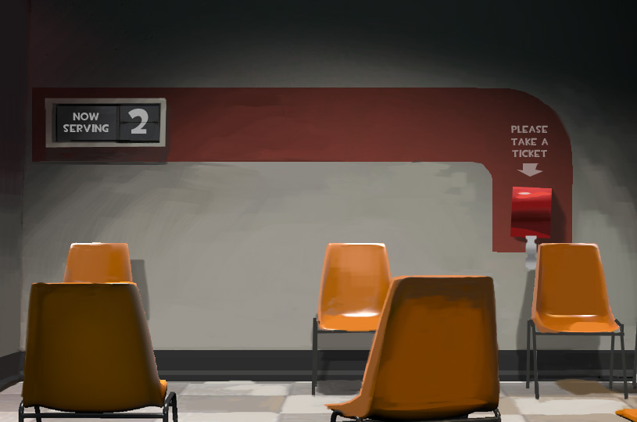
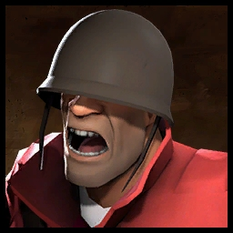
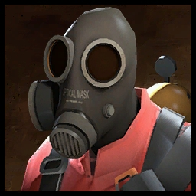
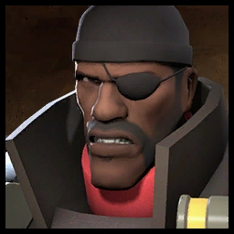

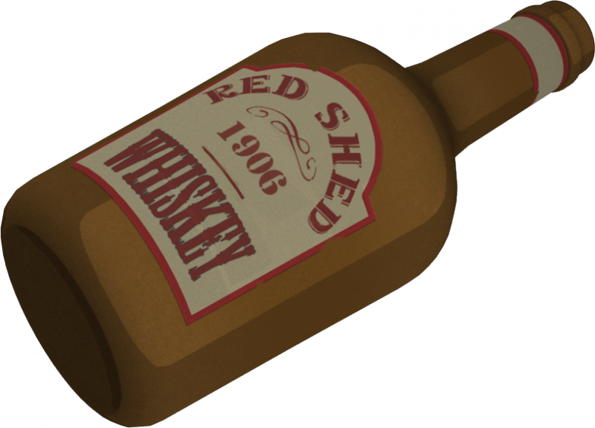

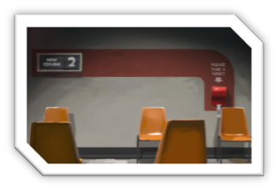
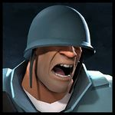
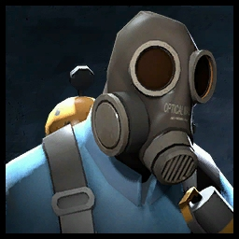
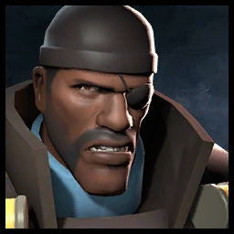
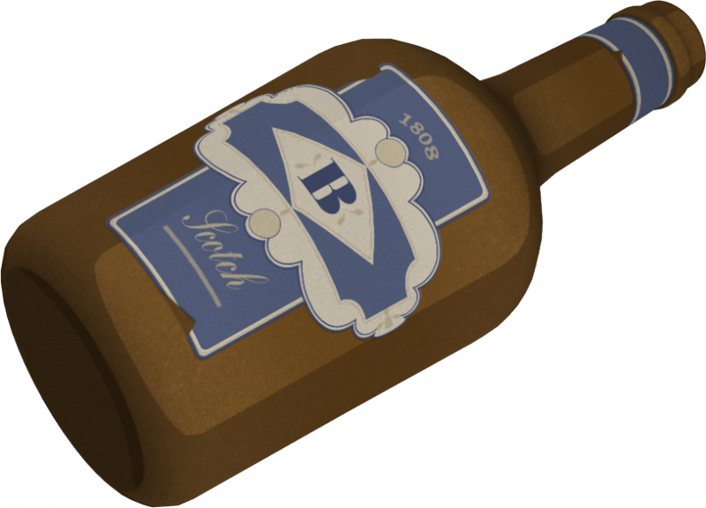
Unknown Person
Fld. Clinic
$600
Jane Doe
MASKED MADMAN
Tavish Finnegan DeGroot
Spy------------------RED
450
hospital----RED
800
SOLDIER-----------RED
BOOM
PYROMANIAC-----RED
DEMOMAN---------RED
501
My knife is sharp, my watch is wound, my ski mask is freshly laundered: time to win. Unlocks the Spy for use in Squads. When questioned about his identity he insisted we didn’t need to know.
Vould you like a second opinion? You are also ugly! This building specializes in the harvesting donation of patients’ skeletons. It occasionally treats battle wounds.
We have the eye of a Tiger, the heart of a Lion, the wings of an eagle, the big muscular arms of panther-man, and the silent majesty of a Kraken!
MMMMPHH mpphh hudda hudda whoo mmmmpppphhhh mmmmpphhhhhhhh mmppphhhh Magic?
I got a good feeling about this match, lads! Dinnae tell anyone….I brought a lot of bloody bombs.
Unknown Person
FLD. Clinic
$600
Jane Doe
MASKED MADMAN
Tavish Finnegan DeGroot
SPY-------------------BLU
350
HOSPITAL------BLU
800
SOLDIER------------BLU
BOOM
PYROMANIAC------BLU
DEMOMAN----------BLU
zzzzz
My knife is sharp, my watch is wound, my ski mask is freshly laundered: time to win. Unlocks the Spy for use in Squads. When questioned about his identity he insisted we didn’t need to know.
Vould you like a second opinion? You are also ugly! This building specializes in the harvesting donation of patients’ skeletons. It occasionally treats battle wounds.
We have the eye of a Tiger, the heart of a Lion, the wings of an eagle, the big muscular arms of panther-man, and the silent majesty of a Kraken!
MMMMPHH mpphh hudda hudda whoo mmmmpppphhhh mmmmpphhhhhhhh mmppphhhh Soupcan?
I gaa a goofeeliy aboot thi-,, thi… lads! Dinnae tell anyone….I brought a lot of blood……..zzzzzzzz

Slide 9
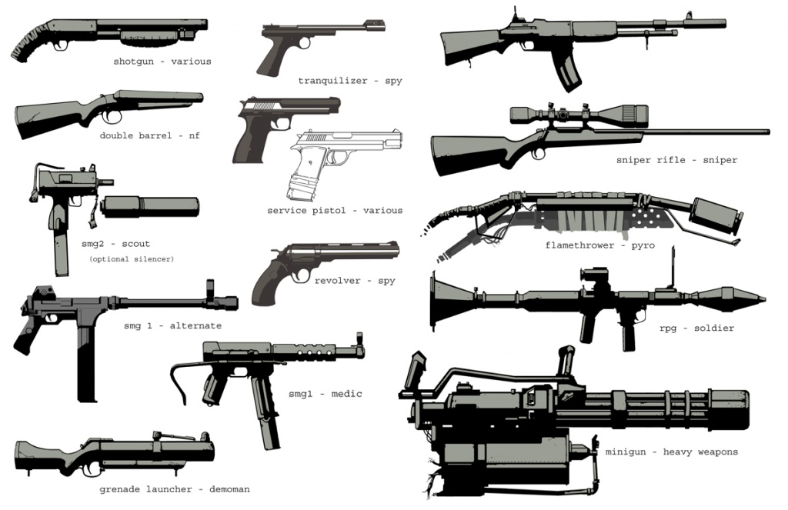







Assault Squad
Custom Weaponry
Cross-Training
Supply Buff
Sabatoge
Squad-----------RED
Squad PErk
LVL 2
Squad PErk
LVL 2
Squad PErk
LVL 3
Squad PErk
LVL 3
War is like a game of chess: with guts on top of it! And instead of chess pieces, there's just brave blood-hungry sons-of-bitches who love war!
‘I have new way to kill cowards.’ Bots in this squad can now be equipped with Non-Stock Weapons.
‘Teams are being scrambled!’ Players of this squad may now switch class at will mid-round.
I Did not have permission to Die!’ This Squad will gain Conch, Backup, or Banner “boost” status effect (choice).
‘I Have been shown…who is the boss.’ This Squad’s Opposing team will gain a “de-buff” status effect of the Perk’s Owner’s choice.
Assault Squad
Duel of the Fates
Spec-Ops
Crush
Grava-Control
Squad-----------Blu
Squad Perk
LVL 3
Squad Perk
LVL 3
Squad Perk
LVL 3
Engineer PErk
LVL 3
War is like a game of chess: with guts on top of it! And instead of chess pieces, there's just brave blood-hungry sons-of-bitches who love war!
‘Freedom!’ Any battle that this squad participates in will be in Medieval Mode.
‘Let’s even this out. Team Scramble!’ Bots will switch to any class available to rebalance the team. (Some Limits)
‘"Hey! Other team! We all got together and we got you a little somethin'. It's an ass-beatin'! We're gonna come over there and give it to you right now!“ Temporarily switch all squad members to one class.
‘’Bid farewell to your precious gravity!’ Get rid of that pesky gravity. Choose the gravity level of the server for the duration of the round.

Slide 10








Frontier Justices
Ubered Buildings
Ninjaneer
Going Viral
Vampirism
Engineer PErk
LVL 3
Engineer PErk
LVL 3
Engineer PErk
LVL 3
Medic PErk
LVL 3
Medic PErk
LVL 3
Revenge Rampage! Get revenge on enemies for destroying a building, this perk gives revenge crits for the entire team when retaking land where a building once stood.
‘That’s what it was made for.’ Increase the dependability of Engineer buildings, This perk increases the health pool of all buildings.
‘You’re all about to have a real bad day.’ Forgot your team, forget the demoknight, it’s time for the ninjaneer to shine. This perk makes the engineer much more viable in combat at the expense of his buildings.
‘Can you feel zhe schadenfreude?’ Release the disease on the enemy! This gives the field medic the “Plague” Status effect that infects enemies on touch.
‘I am ze Ubermench!’ As redistributor of health, you deserve some of it for yourself. You gain health based on the damage you deal.
Godlike
Vaccinator
Kritzkreig
MEDIC!
$ 350
Engineer
$ 250
Medic PErk
LVL 3
Medic PErk
LVL 3
‘Auf Wiedersehen, Schweinehunds!’ Shield your team from the enemies’ weapons. Apply one of the vaccinators passive resistance effects (chosen at the start of the match) to your team.
Medic PErk
LVL 3
Field Agent-----RED
--N/A--
Field Agent-----BLU
--N/A--
‘TODAY! I AM A GOD!’ Increases the Field Medics regen and applies a regen effect to allies in the vicinity.
‘Zat vas doktor-assisted homicide!“’ This perk allows two charges of 4 seconds crits for the entire team to be used at any time during the match
Blood! I need more BLOOD! This field agent is responsible for keeping his teammates alive, and failing that, bringing them back.
I Like to Make Things. This field agent is responsible for constructing bases and buildings, and can be used to bolster defense and attack squads.

Slide 11

Assault Squad
Super Dispenser
Squad
Engineer PErk
LVL 3
War is like a game of chess: with guts on top of it! And instead of chess pieces, there's just brave blood-hungry sons-of-bitches who love war!
‘This button here, builds Teleporters. This button, builds Dispensers. And this little button makes them enemy sum-bitches wish they'd never been born!’ A healing & resupply effect is applied to this squad.

Slide 12









Fight to the Death
Ranged Sabotage
Cardio
Strategic Retreat
Raiders
Squad Ability
LVL 3
Squad Ability
LVL 3
Squad Ability
LVL 3
Squad Ability
LVL 3
Squad Ability
LVL 3
‘A winner knows when to fight and when not to fight! Answer: Never! Stop! Fighting!’ Force any Match of your choice to be fought until the end, the enemy cannot retreat and a Stalemate will result in a sudden death match.
Remove your enemies with extreme prejudice! Use a sniper within a squad to temporarily disable class from another team.
‘I’m not even winded.’ Never skip Cardio day! Increase this squad’s range by allowing it to move two tiles each turn instead of one.
‘I’m not even winded.’ Never skip Cardio day! Increase this squad’s range by allowing it to move two tiles each turn instead of one.
‘All gave some, some gave all! But nobody got a prize but us!’ This squad is now specially trained for Conducting Raids, and can do so at half the cost.
Eureka Effect
Rescue Ranger
Wrangler
Insta-Retreat
Omni-PResence
Engineer Ability
LVL 2
Squad Ability
LVL 2
Engineer Ability
LVL 2
Engineer Ability
LVL 3
Engineer Ability
LVL 3
‘It fixes, it dents craniums, it's the wonder tool of the century!’ Teleport out of danger to HQ or Boot Camp, and get around the map better.
Ranged Repair! Save your teams buildings from extreme range.
‘Yeeeeee-hhhaaaawwww!’ Delay the enemy, wait for your team! Delay an enemy squad from attacking for 1 turn.
Get out of those sticky situations! Teleport away from the attacking squad to safety.
Fortify your efficiency: be anywhere at once! Use this ability to expand the available teleport destinations.

Slide 13









Sigafoo Save
Aerial Deployment
Area Denial
Overdose
Quick-fIx
Engineer Ability
LVL 3
Engineer Ability
LVL 3
Engineer Ability
LVL 3
Medic Ability
LVL 2
Medic Ability
LVL 2
Retrieve your buildings from the clutches of the enemy! Teleport a friendly building from the enemy just before they attack.
‘I built that.’ Build a building from afar! The engineer can now build a structure from a tile away.
‘This thing ain’t on auto-pilot, son!’ Extend the reach of your Wrangler! Protect an extra tile with your Wrangler ability.
‘[A]ttention hepatitis fans: What heritage set would be complete without a rusty old gun that shoots dirty needles?’ Gain a movement buff whenever there is an enemy within 2 tiles of this Field Medic.
Increase your godlike powers of resurrection! This ability provides a boost to the Field Medic when attempting a saving throw on a squad.
Medi-Vac
Ubersaw
Blutsauger
Mega-Heal
Crossbow
Medic Ability
LVL 3
Medic Ability
LVL 3
Medic Ability
LVL 3
Medic Ability
LVL 3
Medic Ability
LVL 3
‘Back from the bloody grave!’ Save your allies and pull them out of harms way. This allows the medic to perform a saving throw while attached to a squad and teleport them back to any Field Clinic Building.
‘Oktoberfest.’ Each successful battle the medic participates in earns an Ubercharge token.
‘Oops! That was not medicine.’ Steal your enemies uber! Roll some RNG to try and hit your enemy.
‘Auf wiedersehen, Dummkopfs!’ Use your Ubercharge to boost your odds at reviving squads! Boosts a medics ability, by 3 dice, to revive at the cost of 2 Ubercharge.
‘his thing might look like an old crossbow of before. However, it's nothing more than a regular syringe gun! Extend your range! Save a friendly team from an extra tile away.

Slide 14


Research Lab

Slide 15



Recruitment Roster
Coming soon…

Slide 16
Research Lab

Slide 17

Recruitment Roster
Coming soon…

